Slide 1
Choosing a seaside holiday destination

Slide 2
Introduction
In this investigation I will analyse which coastal resort is the best holiday location.
I will utilize location and venue data from Foursquare.
I will run through a number of analytical techniques to ascertain the best place to go on holiday
Proximity to location centre.
The number of each type of venue at each location.
Similarity between the different locations.

Slide 3
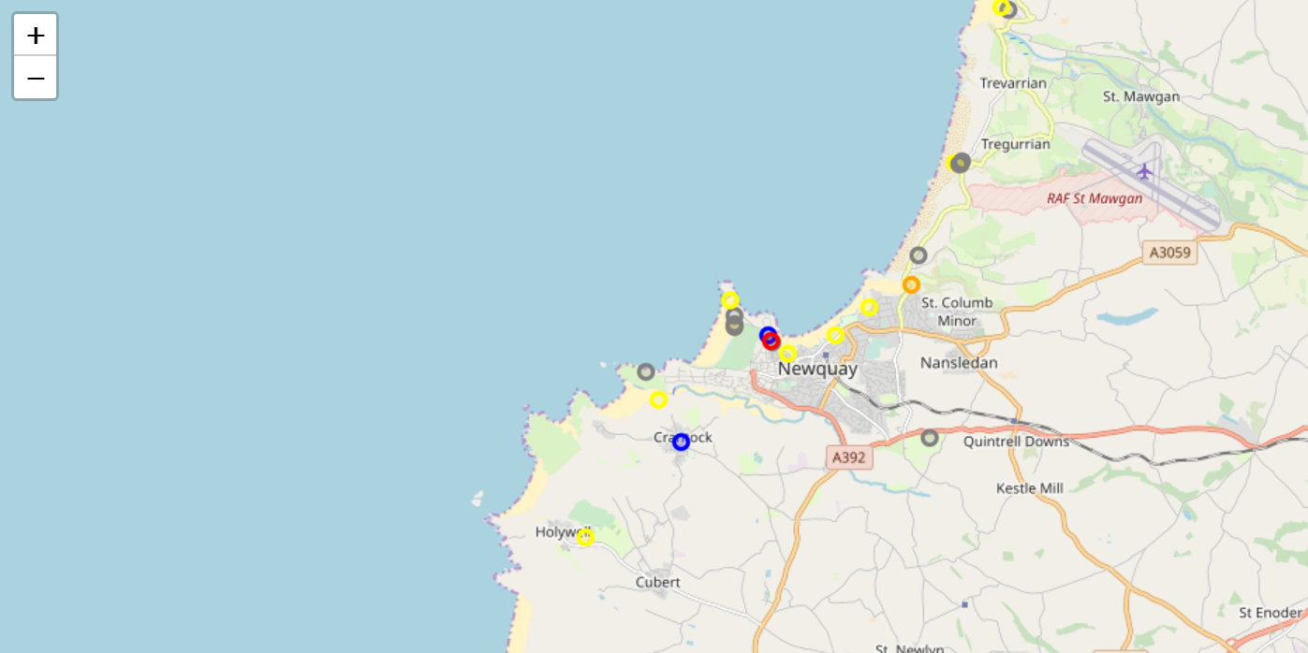
Maps to look at proximity of venues to centre of location
Map showing venues in the vicinity of Newquay.
Maps for all locations in jupyter norebook.

Slide 4
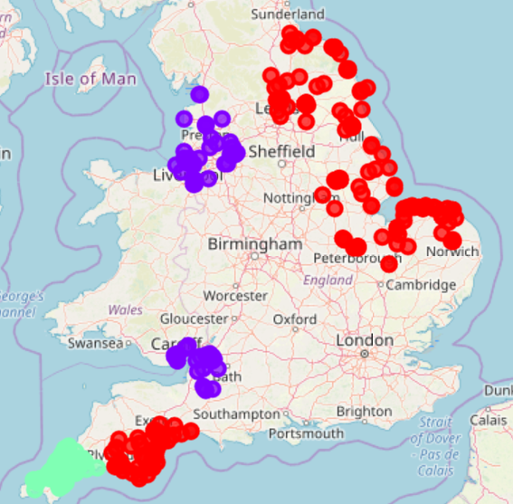
K-Means clustering to show which locations are similar
The map illustrates that the far south west is in its own cluster while the other locations are plit into two clusters.
So holidaying in the south west will provide a different experience to holidaying elsewhere in England.

Slide 5
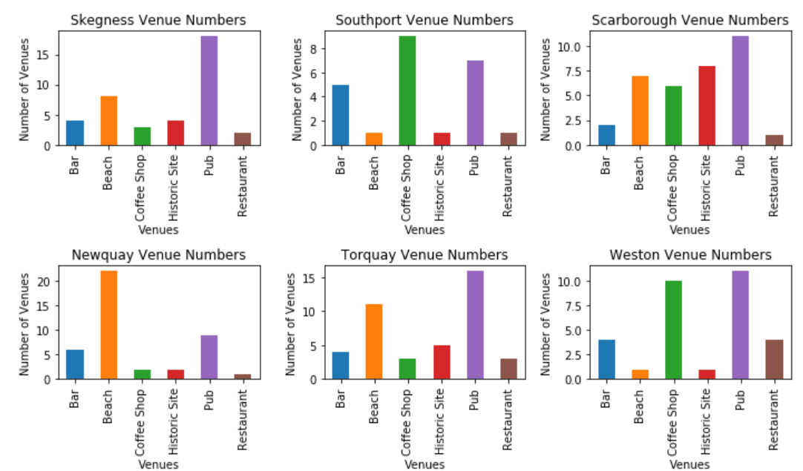
The bar chart demonstrates which locations have the most choice of the different types of venue.

Slide 6
Conclusion
The analysis suggests that Newquay, Torquay or Scarborough would provide the holiday locations with the most attractions to visit.
Some scepticism has to be given to the completeness of the Foursquare datasets for these locations.

